Slide 1
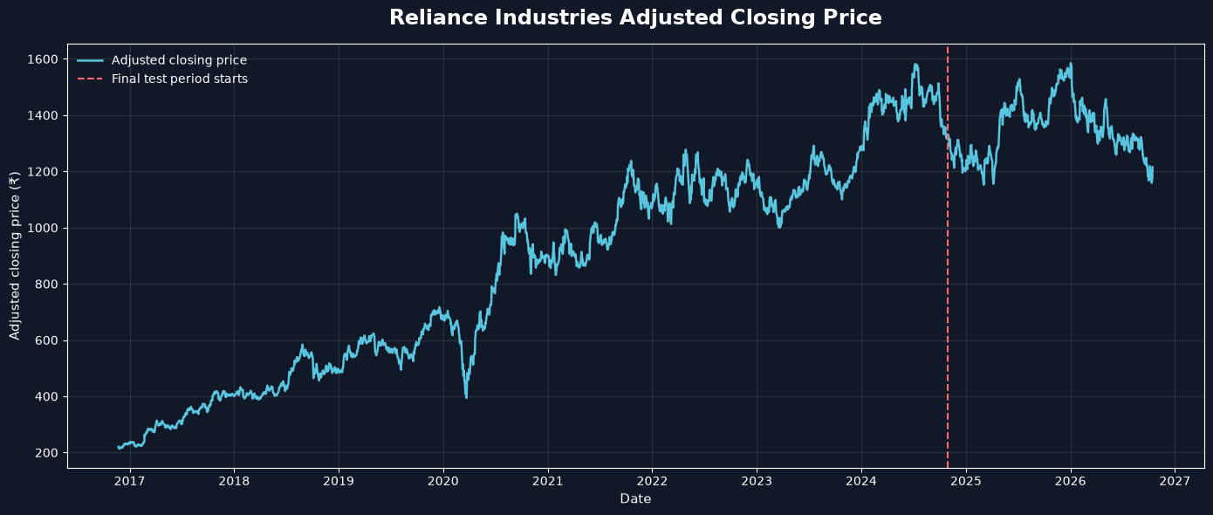
Predicting Stock Price Trend using ML Algorithms
MA ECONOMICS • SEMESTER III
A machine learning study using historical prices and volatility indicators.
Presented by: Raj Savita
Department: USME, DTU
Notes:
Cover slide. Fill in the presenter name and department / university.

Slide 2





Introduction
01 / 13
Predicting Stock Price Direction: Reliance Industries Ltd.
The Company
Reliance Industries Limited (RIL) is one of India's largest and most diversified business groups.
Operates across energy, petrochemicals, retail, digital services and telecommunications.
Stock trades on the National Stock Exchange (NSE) under the ticker RELIANCE.NS
ENERGY | RETAIL | DIGITAL | TELECOM
The Prediction Challenge
Theoretical Context
Stock prices are influenced by a mix of historical price movements, investor sentiment, market-wide trends and macroeconomic factors.
These interactions make short-term price movements difficult to predict consistently.
Efficient Market Hypothesis (EMH) — the extent to which publicly available information can help predict future stock-price movements.
Project Overview
Uses machine learning classification techniques on historical Reliance stock data.
The model looks at information available up to a given day and predicts whether Reliance’s return over the next five trading sessions will be down, flat, or up.
2016 → 2026
Up / Flat/ Down
daily NSE data
Next 5 trading sessions

Slide 3




Research Objective
02 / 13
What are we trying to achieve?
RESEARCH OBJECTIVE
Scope
To develop and evaluate a machine learning model that classifies Reliance Industries’ stock return over the next five trading sessions as down, flat, or up, using recent historical market data.
The study focuses on Reliance Industries’ historical daily market data and a five-trading-session prediction horizon. The flat class is defined using a fixed −1.318% to +1.318% return band, chosen from an earlier calibration period.
The project compares a baseline, logistic regression, and random forest.
It is a learning and model-evaluation study, not a trading strategy.
Data
ML Models
Prediction
Evaluation

Slide 4



Conceptual Framework
03 / 13
Collect historical data
Create Input features
Define the target
Use Reliance’s daily price and volume data of last 10 years.
Summarise recent returns, volatility, daily price range, closing-price position, and trading volume.
Calculate the return over the next five trading sessions:
Below −1.318% → Down
From −1.318% to +1.318% → Flat
Above +1.318% → Up
Train and compare models
Evaluation on test data
Train models on earlier dates and compare their predictions on later validation periods.
Measure how well the selected model predicts data from a later date range.
Data is split chronologically into training, validation and test periods.

Slide 5





Data & Variables (Features)
04 / 13
Daily Reliance Industries price and trading-volume data from Yahoo Finance (yfinance)
Return_1day
Return_5day
Return_20day
Volatility_20day
RELIANCE.NS
RELIANCE.NS
RELIANCE.NS
RELIANCE.NS
Percentage price change over the previous 1 trading session.
Percentage price change over the previous 5 trading sessions.
Percentage price change over the previous 20 trading sessions.
Variation in daily returns over the previous 20 sessions.
TARGET VARIABLE
Daily range pct
Close position
Relative Volume
Trend_5day
The session’s high-to-low price range as a percentage of its closing price.
The closing price’s position within that session’s high-to-low range: near 0 means near the low; near 1 means near the high.
Today’s volume divided by the average volume of the previous 20 sessions. Values above 1 mean higher-than-average volume.
Down(-1): return below -1.318%
Flat(0): return b/w -1.318% & +1.318%
Up(1): return above +1.318%

Slide 6


Methodology & Evaluation Design
05 / 13
Chronological, out-of-sample evaluation against a simple baseline
1
Prepare the data
2
Create the target
3
Chronological split
4
Train & Compare Models
Daily Reliance data was sorted by date, and seven features were created from current and past market information.
The return over the next five trading sessions was classified as down, flat, or up, using the fixed −1.318% to +1.318% flat band.
Calibration period:
24-10-2016 to 09-08-2021 Development period:
23-11-2016 to 21-10-2021
Test period:
29-10-2024 to 15-10-2026
Three models were compared:
Baseline
Logistic Regression
Random Forest
MODELS COMPARED
Majority-class baseline
Logistic Regression
Random Forest
Reference benchmark
It predicted the most common class in the training data.
estimated the probability of each trend class from the features.
300 trees; minimum leaf size 20
combined decision trees to model more complex relationships.

Slide 7

Results: Model Comparison
06 / 13
Cross-validation and holdout performance side by side
Model | Accuracy | Balanced accuracy | Macro F1
Majority baseline | 0.341 | 0.333 | 0.169
Logistic Regression | 0.371 | 0.377 | 0.335
Random Forest | 0.324 | 0.312 | 0.300
Accuracy
No. of correct predictions across all three classes divided by total predictions.
Balanced Accuracy
Calculate recall separately for down, flat, and up, then take the average of those three recall values.
(to not let any class dominate)
Macro F1
How to read the table
Calculate the F1 score separately for down, flat, and up, then take the average of those three scores. Each class has equal weight.
Logistic regression had the strongest average validation results on all three metrics. The baseline’s balanced accuracy is 0.333 because it always predicts one class, giving recall to only that class.
Notes:
Replace the amber placeholders with the values from results_table.csv. No performance values are fabricated in this deck.

Slide 8

Classification Errors: Confusion Matrices
07 / 13
Where each model gets down, flat and up days right and wrong
Logistic Regression
Random Forest
Reading the matrices
Predicted
down
Predicted
flat
Predicted
up
Predicted
down
Predicted
flat
Predicted
up
Actual
down
61
91
7
Actual
down
77
52
30
Logistic regression correctly classified more flat cases (102 vs. 70), while random forest correctly classified more down (77 vs. 61) and up cases (30 vs. 13).
These counts show where each model made correct predictions.
Actual
flat
60
102
13
Actual
flat
64
70
41
Actual
up
47
91
13
Actual
up
54
67
30
Compare the correct predictions alongside the validation scores and overall test metrics to claim which model performed better
Notes:
Use the printed 3x3 matrices from your script and replace each [n] with the count. Rows are actual classes, columns are predicted classes, both ordered down, flat, up.

Slide 9


Interpretation & Limitations
08 / 13
Reading the evidence with appropriate caution
Interpretation & Discussion
Limitations
Logistic regression predicted flat most often and correctly classified 102 of 175 actual flat cases.
It correctly identified only 13 of 151 actual up cases.
Random forest correctly identified more down and up cases, but also made many errors across all classes.
Logistic regression was selected because it had the strongest average validation scores.
On the final test, logistic regression scored 0.363 accuracy, 0.351 balanced accuracy, and 0.320 macro F1. It beat the baseline overall, but performance was modest.
Many down and up cases were classified as flat.
Results depend on the chosen ±1.318% flat band.
The seven price-and-volume features do not include all influences, such as news or company events.
Market patterns can change over time.
Historical performance does not guarantee future results.

Slide 10




Backtest & Feature Importance
10 / 13
Economic relevance of the signal
Backtest chart
Importance chart
Compare each model's final value of ₹1 with buy-and-hold.
Treat permutation importance as predictive association, not causation.
[Insert Growth of ₹1 in test period]
[Insert Permutation importance]
Insert backtest.png
Insert feature_importance.png
Caveat: the current backtest excludes transaction costs, slippage, taxes and execution constraints. The signal uses a close-based prediction, so the assumed trade execution time must be made explicit.
Notes:
Insert backtest.png and feature_importance.png from your run into the dashed frames.

Slide 11

Selected Literature
04 / 13
Prior research that frames the question and the method
1970
Fama (1970)
2004
Lo (2004)
EFFICIENT CAPITAL MARKETS
ADAPTIVE MARKETS HYPOTHESIS
Foundational framework for defining market efficiency and its implications.
Suggests efficiency can vary with competition, institutions and market conditions.
2015
Patel et al. (2015)
2018
Fischer & Krauss (2018)
INDIAN STOCK-INDEX PREDICTION
DEEP LEARNING AND STOCK RETURNS
Compares machine-learning techniques for predicting Indian stock-market indices.
Studies LSTM-based forecasting in the S&P 500 constituent universe.
Research gap / project positioning
A transparent, reproducible comparison of conventional classifiers for one Indian large-cap stock, with a strict time-based holdout and a simple trading simulation.
Notes:
References are starting points; verify full bibliographic details and add any papers required by your instructor.

Slide 12

Classification Errors: Confusion Matrices
09 / 13
Where each model gets the direction right and wrong
Logistic Regression
Best model (choose after results)
Reading the matrices
Predicted down
Predicted up
Predicted down
Predicted up
Rows = actual class [down, up]
Columns = predicted class [down, up]
Actual down
[n]
[n]
Actual down
[n]
[n]
Questions to discuss
Actual up
[n]
[n]
Actual up
[n]
[n]
Does the model miss more up-days or down-days? Does it simply predict the more frequent class?
Blue = correct calls · Amber = errors
Blue = correct calls · Amber = errors
Replace [n] with counts
Replace [n] with counts
A model can achieve reasonable accuracy while performing poorly on one class; inspect class-level errors.
Notes:
Use the printed matrices from your script and replace each [n] with the count.

Slide 13





Conclusion & Future Work
12 / 13
Complete the left column after your final run
Possible extensions
Conclusion
LSTM / other sequence models with careful temporal validation.
Best-performing model
[insert model and test metrics]
Intraday data and explicit execution timing.
Relative to baseline
News sentiment and event indicators.
[insert evidence from CV and holdout]
Transaction costs, slippage and realistic position sizing.
Economic interpretation
[state whether backtest adds evidence beyond classification metrics]
Rolling-window evaluation across market regimes.
Main takeaway: the objective is not only to predict direction, but to test whether any apparent signal is robust, out-of-sample and economically meaningful.
Notes:
Fill in the three amber placeholders once the final results are in.

Slide 14

References & Reproducibility
13 / 13
Sources and tools behind the study
1
Fama, E. F. (1970). Efficient Capital Markets: A Review of Theory and Empirical Work. The Journal of Finance, 25(2), 383–417.
2
Lo, A. W. (2004). The Adaptive Markets Hypothesis. The Journal of Portfolio Management, 30(5), 15–29.
Patel, J., Shah, S., Thakkar, P., & Kotecha, K. (2015). Predicting stock and stock price index movement using Trend Deterministic Data Preparation and machine learning techniques. Expert Systems with Applications, 42(1), 259–268.
3
Fischer, T., & Krauss, C. (2018). Deep learning with long short-term memory networks for financial market predictions. European Journal of Operational Research, 270(2), 654–669.
4
Data and code
Record package versions and the date of data download for reproducibility.
yfinance
scikit-learn
pandas
NumPy
Matplotlib
Notes:
Before submission: verify citations, add your course / institution details, and replace all bracketed placeholders with outputs from your own run.

Slide 15

Target Variable & Feature Engineering
06 / 13
From raw series to model-ready inputs
Target (t + 1)
Price-based features
Market / macro features
1 if next trading day's close > today's close; otherwise 0.
Daily and lagged returns, 5-day return, 5/20-day moving-average ratio, 10-day volatility, RSI(14).
Volume ratio, India VIX level/change, USD/INR return, Brent return, S&P 500 return, US yield change, Nifty return.
Preprocessing in the script
Align external series to Reliance trading dates and forward-fill missing macro observations.
Replace zero volume with missing values; remove rows with missing or infinite feature values.
Drop the final row because its next-day target is unavailable.
1
2
3
Important validation: confirm each feature would have been observable at the chosen prediction time.

